Slide 1
StrideSync
Fitness Tracker Application
TEAM MEMBERS MANAN ARORA (500120456) VANSH GUPTA (500123239) ANJALI SONI (500126799)

Slide 2
Introduction
StrideSync is a fitness tracker application.
It helps monitor daily health activities like steps, water intake, sleep, and provides daily fitness tips.
Built using Java and MySQL.

Slide 3
Project Goals
Track various health metrics effectively.
Provide meaningful insights to users about their fitness journey.
Ensure data accuracy and security.
Lay foundation for future enhancements.

Slide 4
Application Features
Steps Tracking
Heartbeat Monitor
Water Intake Logging
Sleep Tracking
Daily Tips
Workout Section
Secure Login
Trainer Data Entry
Performance Analysis

Slide 5
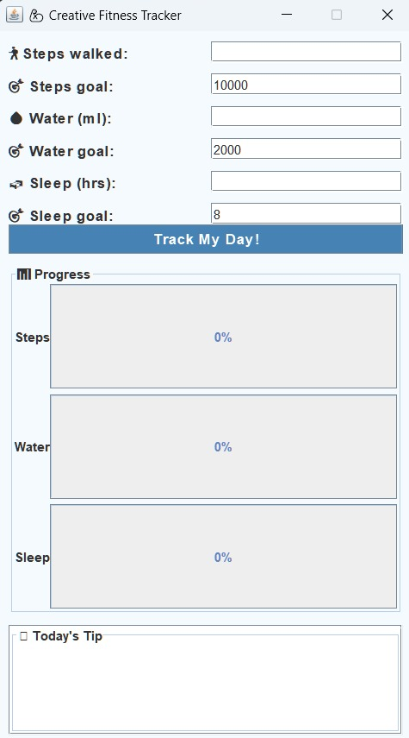
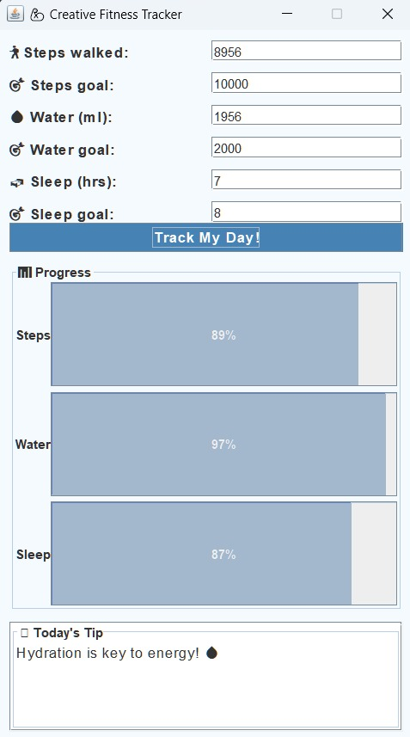
Demo Time
A walkthrough of the application's interface and functionality.
Implementation details and application behavior when executed.

Slide 6
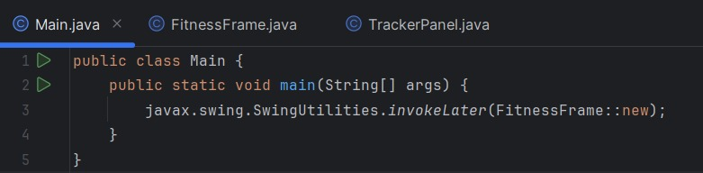
Code: main.java

Slide 7
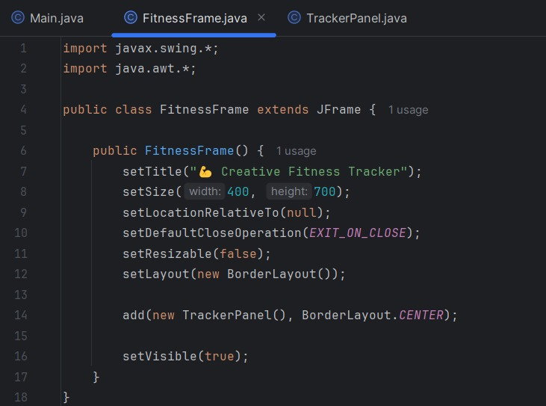
Code: fitnessframe.java

Slide 8
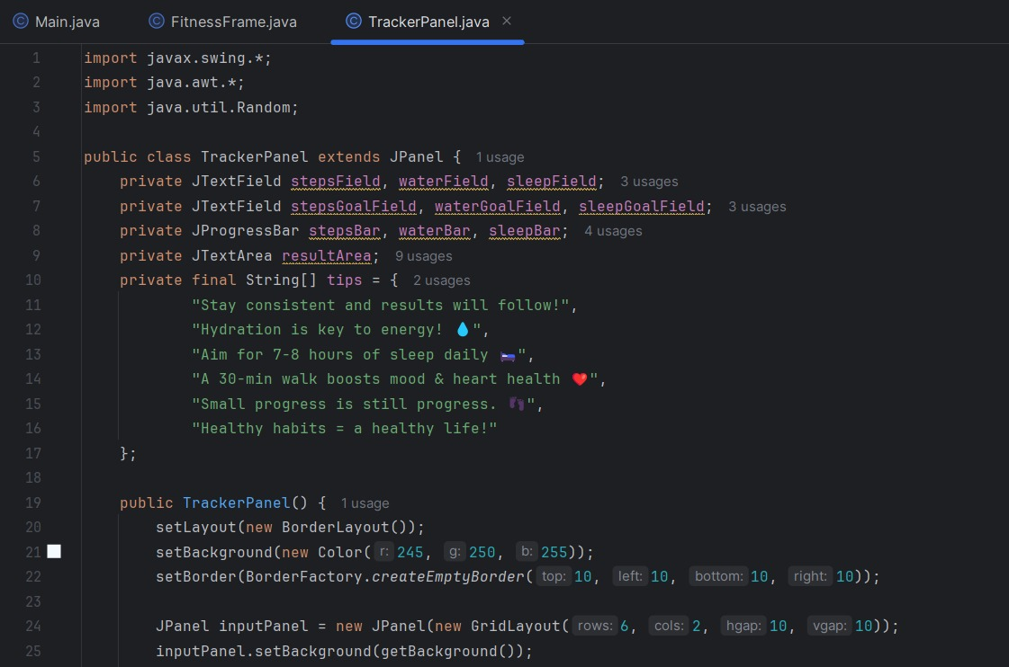
Code: trackerpanel.java - Part 1

Slide 9
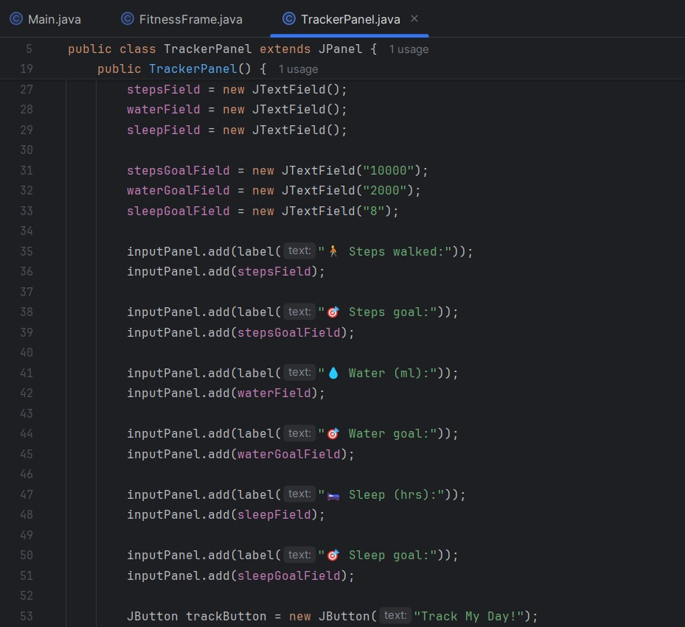
Code: trackerpanel.java - Part 2

Slide 10
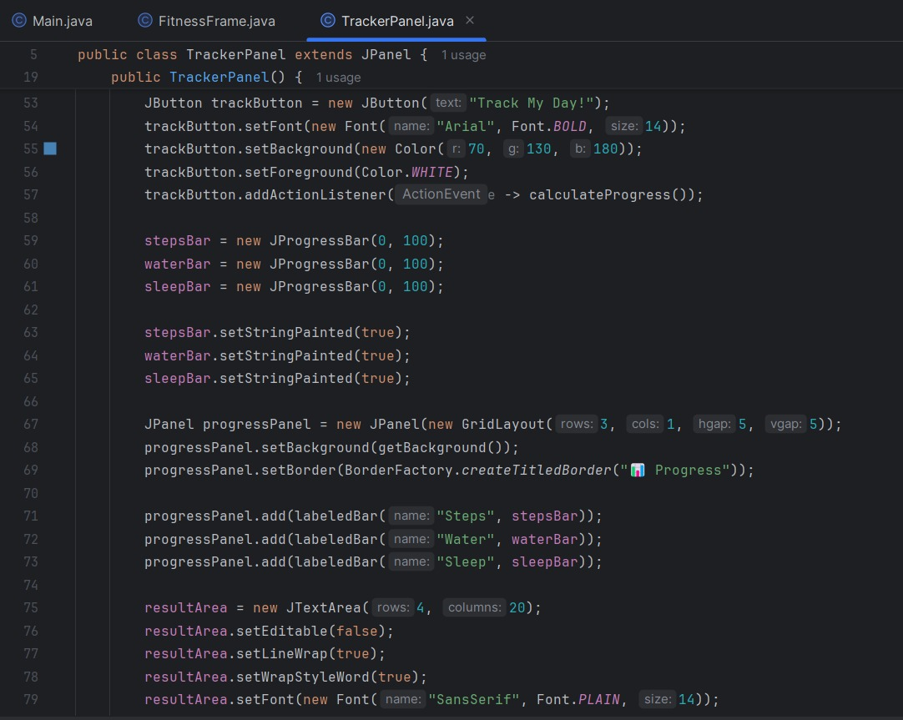
Code: trackerpanel.java - Part 3

Slide 11
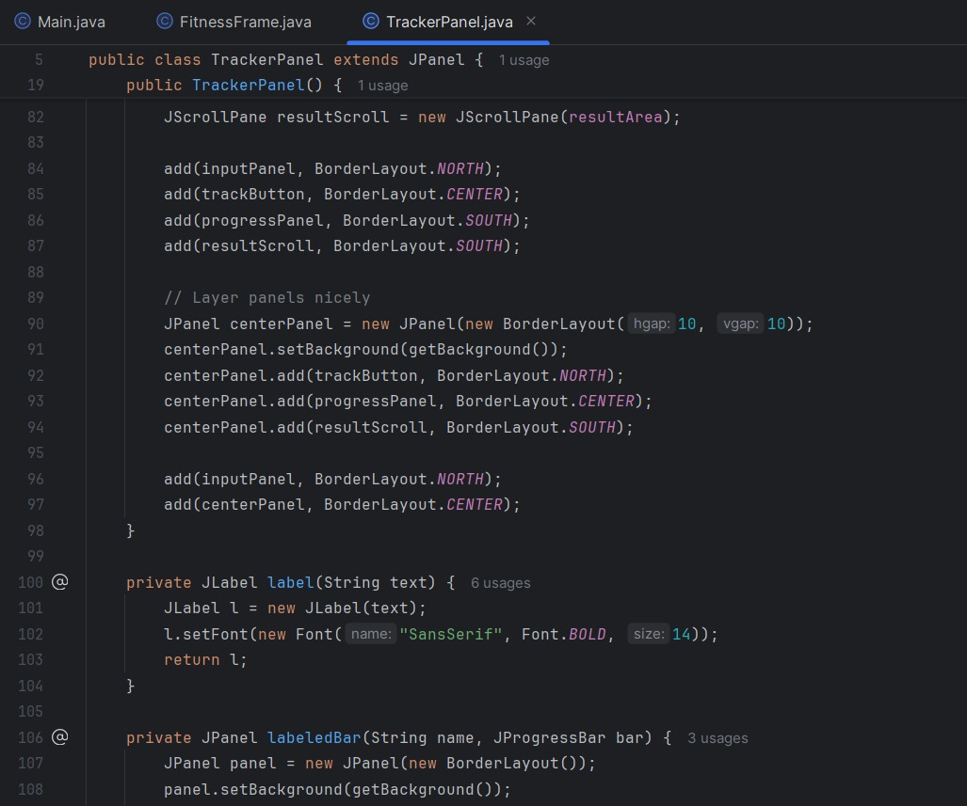
Code: trackerpanel.java - Part 4

Slide 12
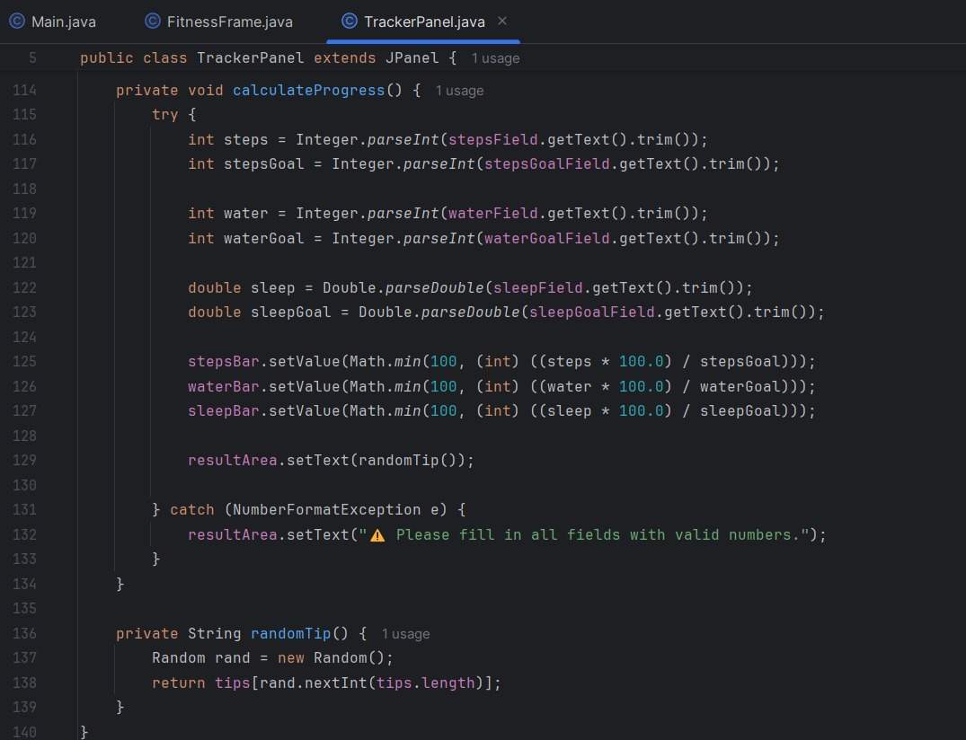
Code: trackerpanel.java - Part 5

Slide 13
OOP Principles Used
Encapsulation - Wrapping data and methods into a single unit (class) to protect it from outside interference.
Polymorphism - Ability of objects to take many forms, allowing the same method to behave differently on different classes.
Inheritance - Mechanism where one class acquires properties and behavior (methods) of another class.
Abstraction - Hiding internal details and showing only the essential features to the user.

Slide 14
Tools and Technologies
MySQL: A popular open-source relational database management system used to store and manage structured data.
JDBC (Java Database Connectivity): A Java API that allows Java programs to connect to and interact with databases like MySQL.
Exception Handling: A mechanism in Java to handle runtime errors gracefully using try-catch blocks, preventing crashes and improving reliability.
Java: A versatile, object-oriented programming language widely used for building cross-platform applications, especially desktop and web apps.
Sorting Algorithms: Methods used to arrange data in a particular order (ascending/descending); essential for performance analysis and user-friendly output.

Slide 15
Conclusion and Learnings
Gained practical experience in Java development.
Learned how to integrate databases using JDBC.
Understood application of OOP principles in real-world projects.
Future Scope: Graphical performance views, Admin dashboard, more tracking features.

Slide 16
THANK YOU!!

